Slide 1
Windows presentation foundation
PLMXpert, 12 juli 2023

Slide 2
Contents
Windows Presentation Foundation
Model-View-ViewModel
Layout
Binding
Notes:
https://www.c-sharpcorner.com/UploadFile/1a81c5/a-simple-wpf-application-implementing-mvvm/
https://github.com/microsoft/WPF-Samples/tree/main
https://learn.microsoft.com/en-us/dotnet/desktop/wpf/getting-started/walkthrough-my-first-wpf-desktop-application?view=netframeworkdesktop-4.8

Slide 3
WPF
Notes:
https://learn.microsoft.com/en-us/dotnet/desktop/wpf/getting-started/walkthrough-my-first-wpf-desktop-application?view=netframeworkdesktop-4.8

Slide 4
Model-view-viewmodel
Why should you, as a developer, even care about the Model-View-ViewModel pattern? There are a number of benefits this pattern brings to both WPF and Silverlight development. Before you go on, ask yourself:
Do you need to share a project with a designer, and have the flexibility for design work and development work to happen near-simultaneously?
Do you require thorough unit testing for your solutions?
Is it important for you to have reusable components, both within and across projects in your organization?
Would you like more flexibility to change your user interface without having to refactor other logic in the code base?
If you answered “yes” to any of these questions, these are just a few of the benefits that using the MVVM model can bring for your project.

Slide 5
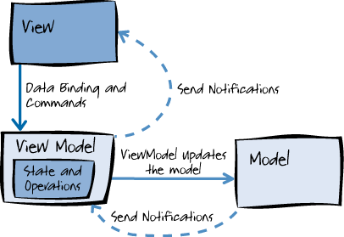
mvvm

Slide 6
model
The model is what I like to refer to as the domain object. The model represents the actual data and/or information we are dealing with. An example of a model might be a contact (containing name, phone number, address, etc) or the characteristics of a live streaming publishing point.
The key to remember with the model is that it holds the information, but not behaviors or services that manipulate the information. It is not responsible for formatting text to look pretty on the screen, or fetching a list of items from a remote server (in fact, in that list, each item would most likely be a model of its own). Business logic is typically kept separate from the model, and encapsulated in other classes that act on the model. This is not always true: for example, some models may contain validation.
It is often a challenge to keep a model completely “clean.” By this I mean a true representation of “the real world.” For example, a contact record may contain a last modified date and the identity of the modifying user (auditing information), and a unique identifier (database or persistence information). The modified date has no real meaning for a contact in the real world but is a function of how the model is used, tracked, and persisted in the system.

Slide 7
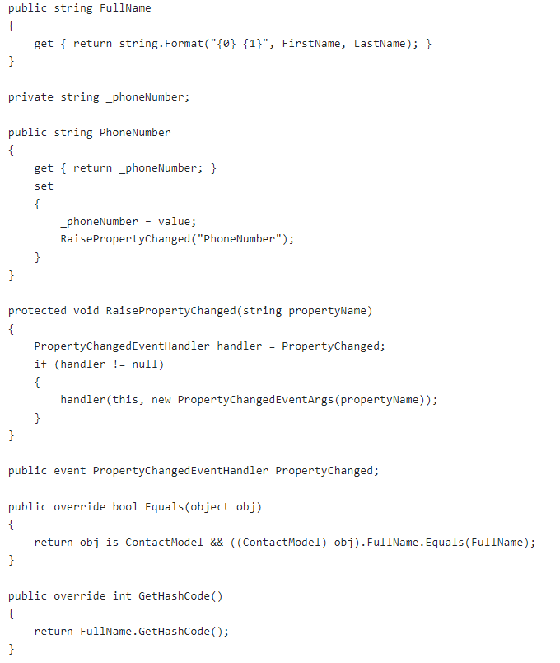
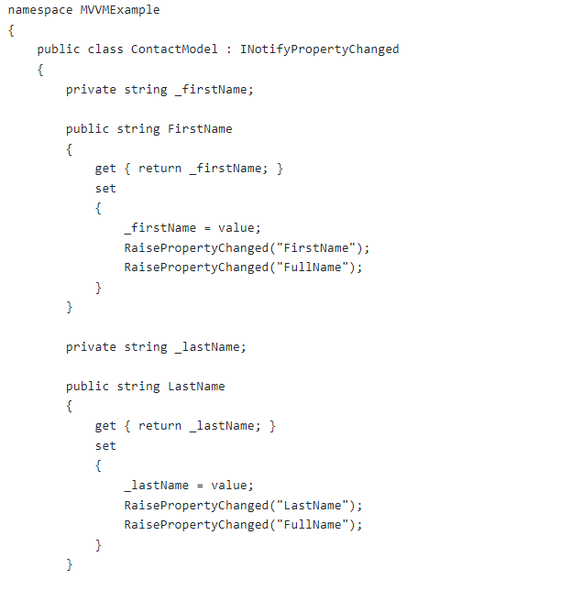

Slide 8
view
The view is what most of us are familiar with and the only thing the end user really interacts with. It is the presentation of the data. The view takes certain liberties to make this data more presentable. For example, a date might be stored on the model as number of seconds since midnight on January 1, 1970 (Unix Time). To the end user, however, it is presented with the month name, date, and year in their local time zone. A view can also have behaviors associated with it, such as accepting user input. The view manages input (key presses, mouse movements, touch gestures, etc) which ultimately manipulates properties of the model.
In MVVM, the view is active. As opposed to a passive view which has no knowledge of the model and is completely manipulated by a controller/presenter, the view in MVVM contains behaviors, events, and data-bindings that ultimately require knowledge of the underlying model and viewmodel. While these events and behaviors might be mapped to properties, method calls, and commands, the view is still responsible for handling it’s own events and does not turn this completely over to the viewmodel.
One thing to remember about the view is that it is not responsible for maintaining its state. Instead, it will synchronize this with the viewmodel.

Slide 9
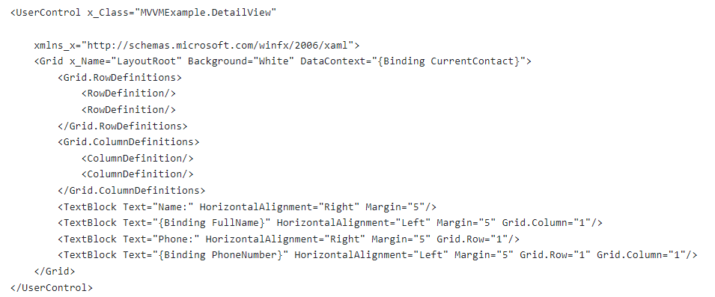
view

Slide 10
Viewmodel (controller)
The viewmodel is a key piece of the triad because it introduces Presentation Separation, or the concept of keeping the nuances of the view separate from the model. Instead of making the model aware of the user’s view of a date, so that it converts the date to the display format, the model simply holds the data, the view simply holds the formatted date, and the controller acts as the liaison between the two. The controller might take input from the view and place it on the model, or it might interact with a service to retrieve the model, then translate properties and place it on the view.
The viewmodel also exposes methods, commands, and other points that help maintain the state of the view, manipulate the model as the result of actions on the view, and trigger events in the view itself.
MVVM, while it evolved “behind the scenes” for quite some time, was introduced to the public in 2005 via Microsoft’s John Gossman blog post about Avalon (the code name for Windows Presentation Foundation, or WPF). The blog post is entitled, Introduction to Model/View/ViewModel pattern for building WPF Apps and generated quite a stir judging from the comments as people wrapped their brains around it.
Here is what a sample view model might look like. We’ve created a BaseINPC class (for “INotifyPropertyChanged”) that has a method to make it easy for raising the property changed event.

Slide 11
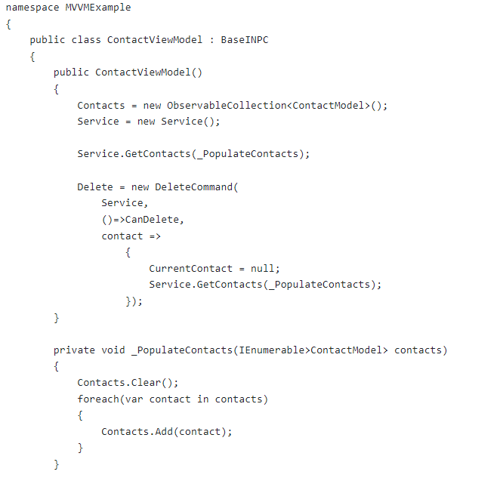
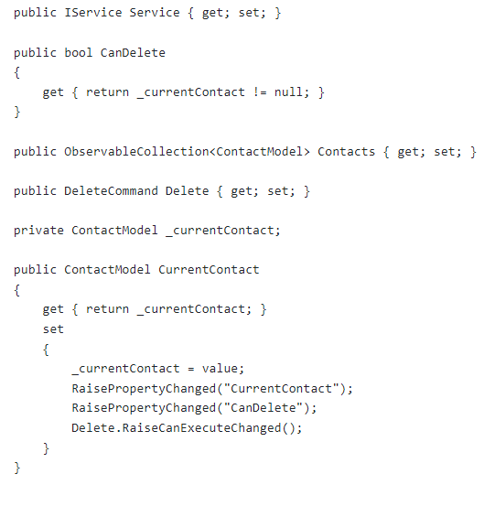

Slide 12
This view model is obviously designed to manage a list of contacts. It also exposes a delete command and a flag to indicate whether delete is allowed (thus maintaining state for the view). Often the flag would be part of the command object, but the example is in Silverlight 3 which does not have native support for command binding, and I wanted to show a simple solution that didn’t require a fancy framework. The view model here makes a concrete reference to the service, you would most likely wire in that reference externally or use a dependency injection framework. What’s nice is we have the flexibility to build it like this initially and then refactor as needed. It fetches the list of “contacts” right away, which is a hard-coded list of me and someone a little more popular. The phone numbers, of course, are faked.
Let’s get a little more specific and look at how this would be implemented in a sample application. Here is what an X-ray of a sample MVVM set up may look like:
So what can we gather from this snapshot?
First, the IConfig represents a configuration service (in a newsreader it may contain the account information and feeds that are being fetched), while the IService is “some service” – perhaps the interface to fetch feeds from RSS sources in a news reader application.

Slide 13
The View and the ViewModel
The view and the viewmodel communicate via data-binding, method calls, properties, events, and messages
The viewmodel exposes not only models, but other properties (such as state information, like the “is busy” indicator) and commands
The view handles its own UI events, then maps them to the viewmodel via commands
The models and properties on the viewmodel are updated from the view via two-way databinding
Two mechanisms that often factor into implementations of the pattern are triggers (especially data triggers) in WPF, and the Visual State Manager (VSM) in Silverlight. These mechanisms help implement the pattern by binding UI behaviors to the underlying models. In Silverlight, the VSM should be the primary choice for coordination of transitions and animations.

Slide 14
The ViewModel and the Model
The viewmodel becomes wholly responsible for the model in this scenario. Fortunately, it’s not alone:
The viewmodel may expose the model directly, or properties related to the model, for data-binding
The viewmodel can contain interfaces to services, configuration data, etc in order to fetch and manipulate the properties it exposes to the view

Slide 15
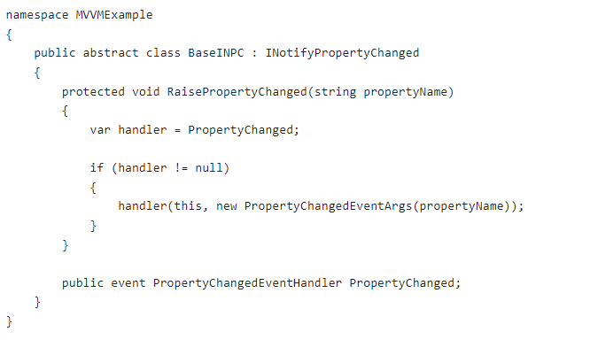
A Basic MVVM Framework
In my opinion, a basic MVVM framework really only requires two things:
A class that is either a DependencyObject or implements INotifyPropertyChanged to fully support data-binding, and
Some sort of commanding support.

Slide 16
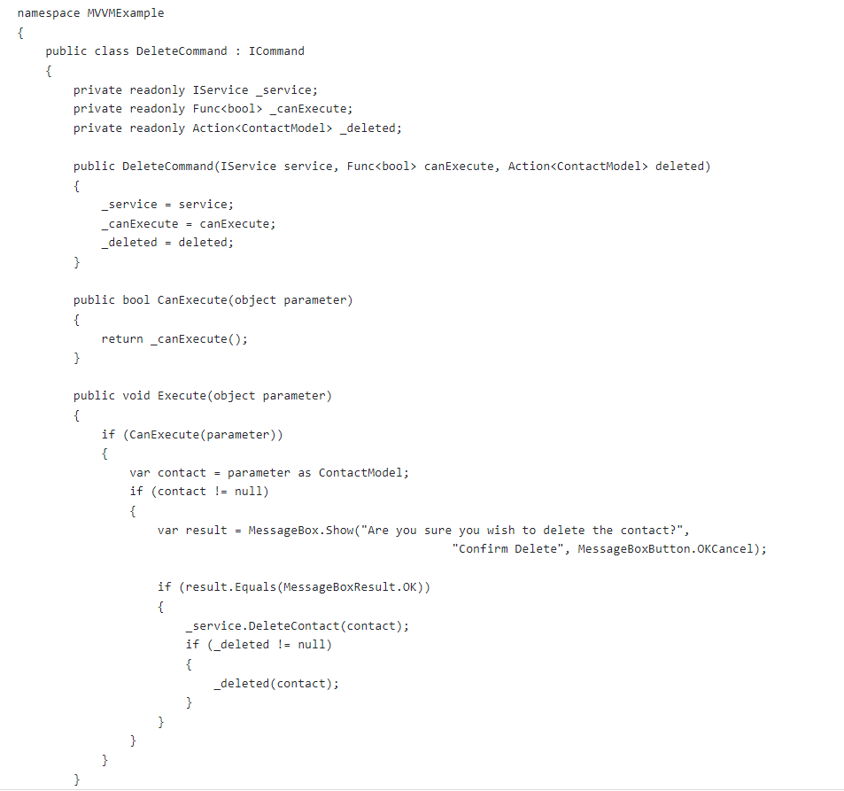
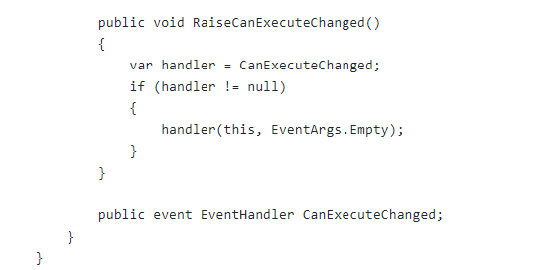

Slide 17
List with Selection
How do you handle a combo box used for selection of a single, or multiple, items with MVVM? It’s actually fairly straightforward. In fact, imagine a scenario where you have a combo-box that has a list of contact names, and another view on the same page that shows the contact details when selected. The ViewModel would look something like this, assuming I’m using MEF to wire dependencies (to show you a different way from the reference application):

Slide 18
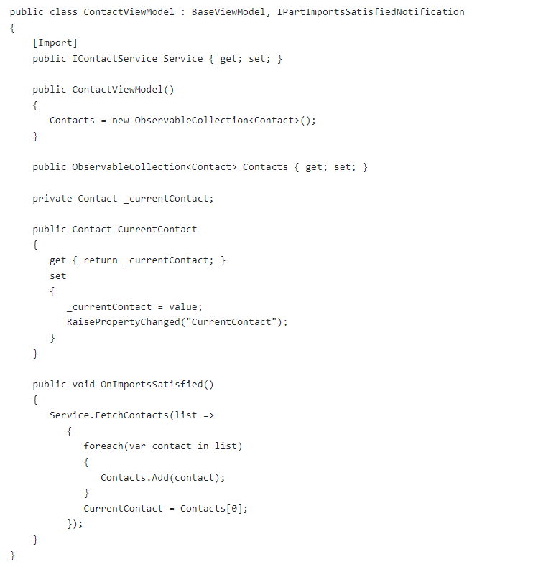

Slide 19
Wpf data binding
https://learn.microsoft.com/en-us/dotnet/desktop/wpf/data/?view=netdesktop-7.0

